Slide 1
SRI HARI DEGREE COLLEGE
(Permanently Affiliated to Yogi Vemana University, Kadapa)
Recognized by UGC New-Delhi under Section 2(f) &12(8)
An ISO 9001:2015Certified Institution
#45/290-10,BalajiNagar,Kadapa,A.P.,INDIA-516003
E-Mail:sriharidc047@gmail.com Web: www.sriharidegreecollege.ac.in ©9440074132
prepared
by
DR.V.SUBBAREDDY (H.O.D)
Dept.of Mathematical Sciences

Slide 2
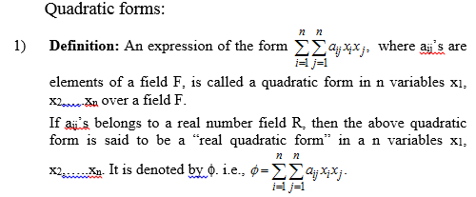

Slide 4
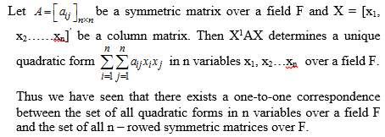

Slide 5
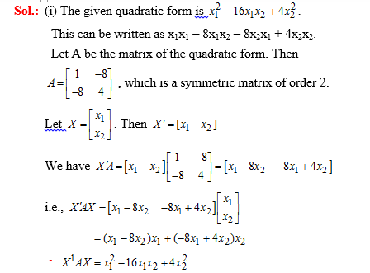

Slide 6
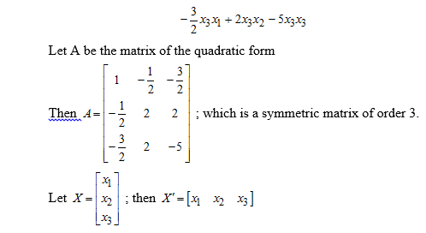

Slide 7
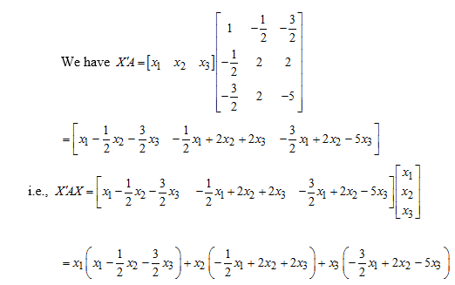

Slide 8
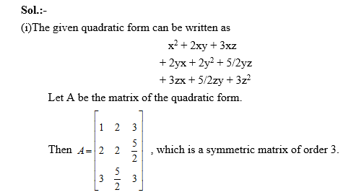

Slide 9
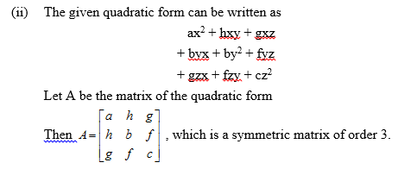
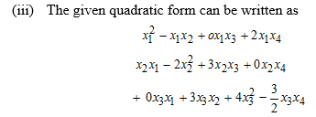

Slide 10
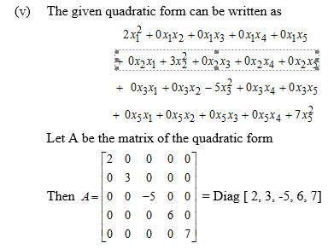

Slide 11
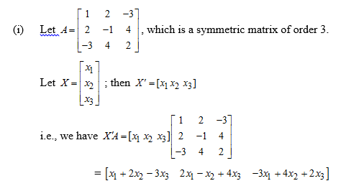

Slide 12
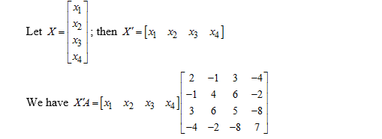

Slide 14
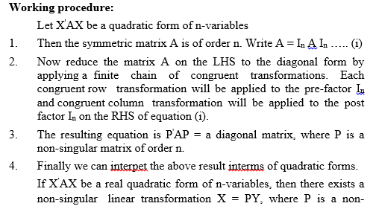

Slide 16
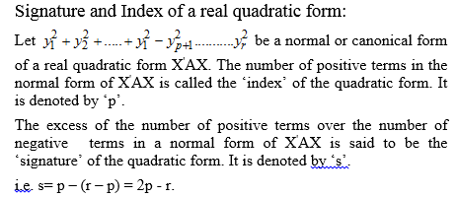

Slide 17
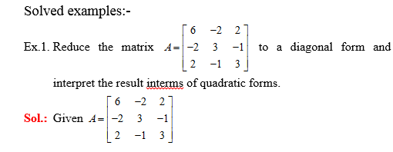

Slide 18
